Slide 1





Sentimental Analysis of
Tweets

Slide 2
Team Details
S.NO | NAME | REGISTER NUMBER
1. | PEPAKAYALA TEJA | 99220040382
2. | M.V.N.AMRUTH SAI | 99220040641
3. | G.VENKAT SHARAN | 99220040855
4. | J.GURUNADHAM | 99220040544

Slide 3

Problem
Statement
Sentiment analysis of social media posts :
Sentiment analysis of social media posts is the process of automatically determining the sentiment or emotion expressed in a text message, such as a tweet, Facebook post, or blog comment. This task is commonly performed using natural language processing (NLP) and machine learning techniques like Support Vector Machine (SVM)

Slide 4
Abstract
Objectives
Algorithm Used
Libraries Used
Working Principle
Flow Chart
Visualizations and Plots
Literature Review
References
Table of
Contents

Slide 5
In today's world, social media platforms like Twitter are where people share their thoughts and feelings openly. Understanding these emotions expressed in tweets can help us learn a lot, like how people feel about a product or react to current events. Sentiment analysis is a way to figure out if a tweet is positive (happy, excited) or negative (sad, upset).
In this project, we're focusing on analyzing sentiments in tweets from Twitter using a method called Support Vector Machines (SVM). Our goal is to build a smart computer program that can tell if a tweet is saying something positive or negative accurately. By doing this, we hope to help businesses, researchers, and anyone interested in understanding people's feelings on Twitter better.
Abstract

Slide 6
The primary aim is to develop a sentiment analysis model using Support Vector Machine (SVM)
Classify the comments of the tweets into either positive or negative to analyze the users opinion toward the tweet.
Evaluate the performance of the sentiment analysis model on the Twitter dataset using appropriate evaluation metrics.
Explore potential applications of the sentiment analysis model, such as real-time monitoring of public opinion, brand sentiment analysis, or trend detection on social media platforms.
Objectives

Slide 7
Support Vector Machine (SVM):
SVM, or Support Vector Machines, is like a smart tool we use in our project. Imagine you have a bunch of dots on a paper, some blue and some red, and you want to draw a line to separate them. SVM helps us draw this line (hyperplane) in a clever way so that it's in the middle and keeps the blue dots on one side and the red dots on the other side as much as possible.
In our project, we're dealing with tweets on Twitter. Some tweets are happy (positive) and some are not so happy (negative). SVM helps us build a system that looks at these tweets and figures out which ones are positive and which ones are negative.
Algorithm
Used

Slide 8
The code utilizes several libraries for various tasks in natural language processing (NLP) and machine learning
NumPy - for numerical computations
Pandas - for data manipulation and analysis
BeautifulSoup - used for web scraping
Matplotlib.pyplot - for creating plots
Seaborn - a statistical data visualization library
NLTK - for natural language processing tasks
Scikit-learn - for data mining
Libraries
Used

Slide 9
Data preparation: Cleaning and preprocessing text data.
Feature extraction: Converting text into numerical features.
Model training: Training SVM to find optimal decision boundaries.
Making predictions: Using trained model for sentiment classification.
Evaluation: Assessing performance using metrics like accuracy.
Working
Principle

Slide 10
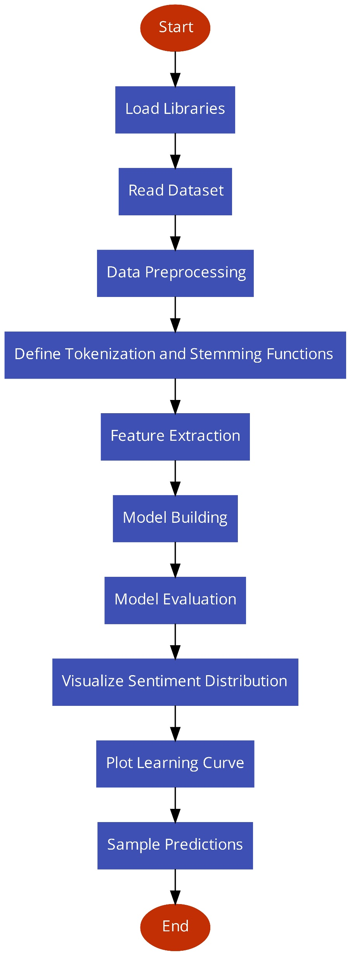
Flow Chart

Slide 11
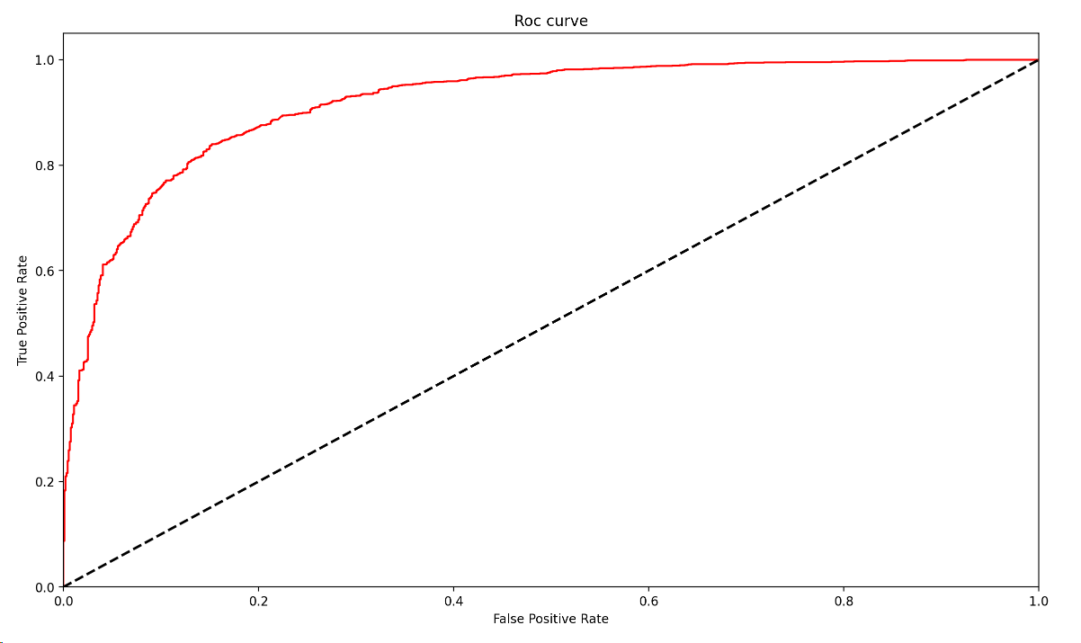
ROC CURVE
Visualizations
&
Plots

Slide 12
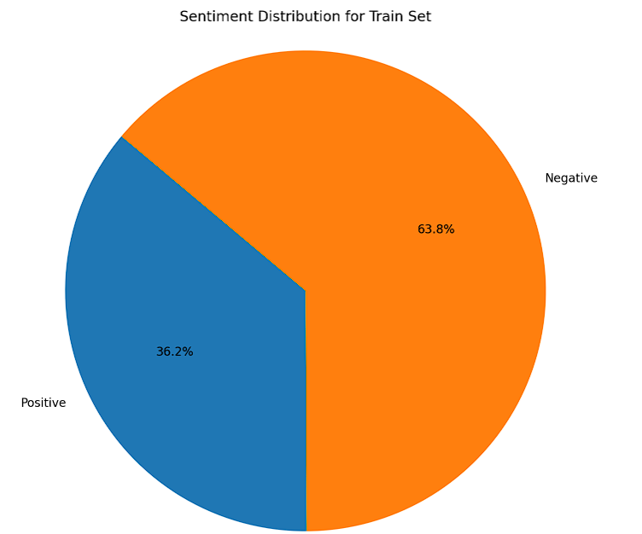
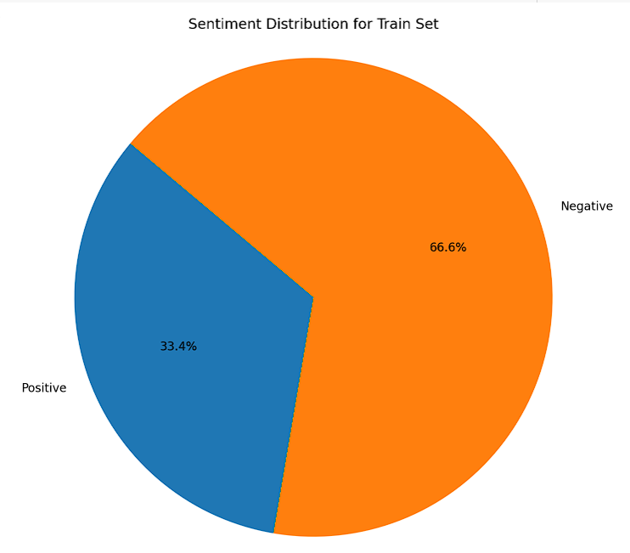
SENTIMENT DISTRIBUTION
TRAIN SET
Visualizations
&
Plots
TEST SET

Slide 13
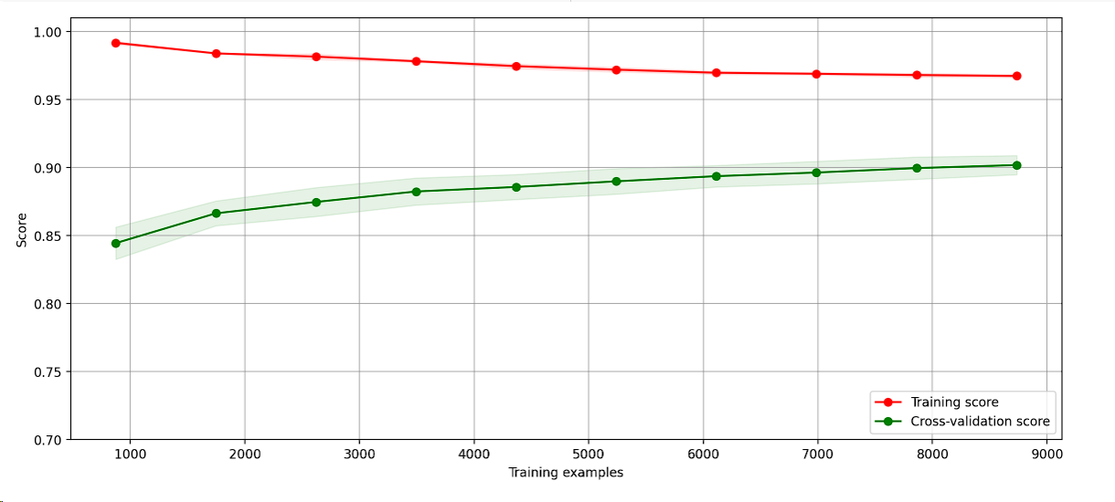
LEARNING CURVE
Visualizations
&
Plots

Slide 14
Oil Sector and Sentiment Analysis (2023)
A Review published by Marcus Vinicius Bastos Santos et al. This paper reviews various methods, including SVM, to explore the timeliness of news regarding the oil price, highlighting the increasing prevalence of machine learning-based methods in recent years1.
2. SVM Optimization for Sentiment Analysis (2018)
A review by M. Ahmad et al. This study, published in 2018, proposes a technique to tune SVM performance using the grid search method for sentiment analysis and evaluates the technique using precision, recall, and f-measure metrics.
Literature
Review

Slide 15
3. Systematic reviews in sentiment analysis: a tertiary study (2021)
A review by Alexander Ligthart et al., published in 2021. This review examines the use of various machine learning algorithms, including SVM, for sentiment analysis, highlighting LSTM and CNN as the most used deep learning algorithms in the field.
4. Sentiment analysis: A survey on design framework, applications and future scopes (2023)
A review by Monali Bordoloi and S. Biswas, published in 2023. This survey presents a comprehensive overview of different techniques and algorithms associated with designing effective sentiment analysis models, proposing potential multidisciplinary application areas based on data contents1.
Literature
Review

Slide 16
Sentiment Analysis using SVM. Sentiment Analysis is the NLP technique… | by Vasista Reddy | ScrapeHero | Medium
Full article: Sentiment Analysis of Short Texts Using SVMs and VSMs-Based Multiclass Semantic Classification (tandfonline.com)
Sentiment analysis using Support Vector Machine | IEEE Conference Publication | IEEE Xplore
Full article: Sentiment Analysis of Short Texts Using SVMs and VSMs-Based Multiclass Semantic Classification (tandfonline.com)
Sentiment Analysis of Text Using SVM | SpringerLink
References

Slide 17
End
Thank you
Do you have any queries?

